Slide 1
BALTIMORE CITY
CRIME DATA ANALYSIS
By - Kunal Rewade

Slide 2
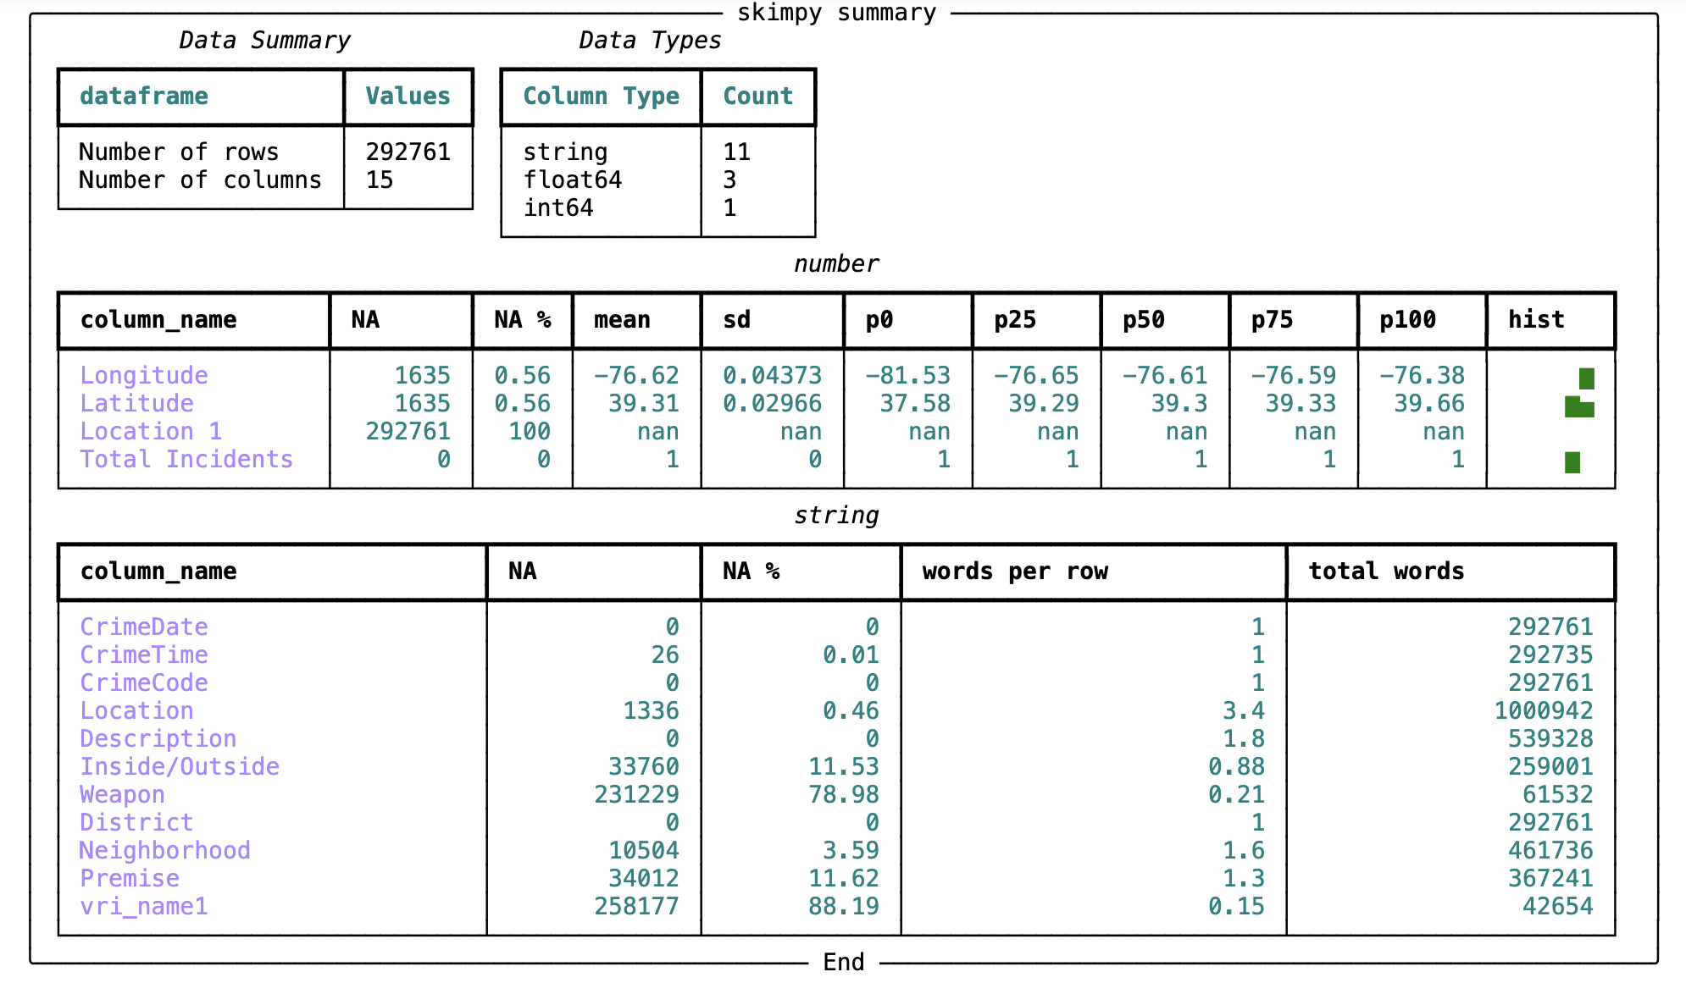
Raw Data
Raw data had several missing values which can lead to misleading results and assumptions.
3 columns were having more than 75 % missing values
2 columns had around 11% missing values.
Several other columns also had some minor missing value.

Slide 3
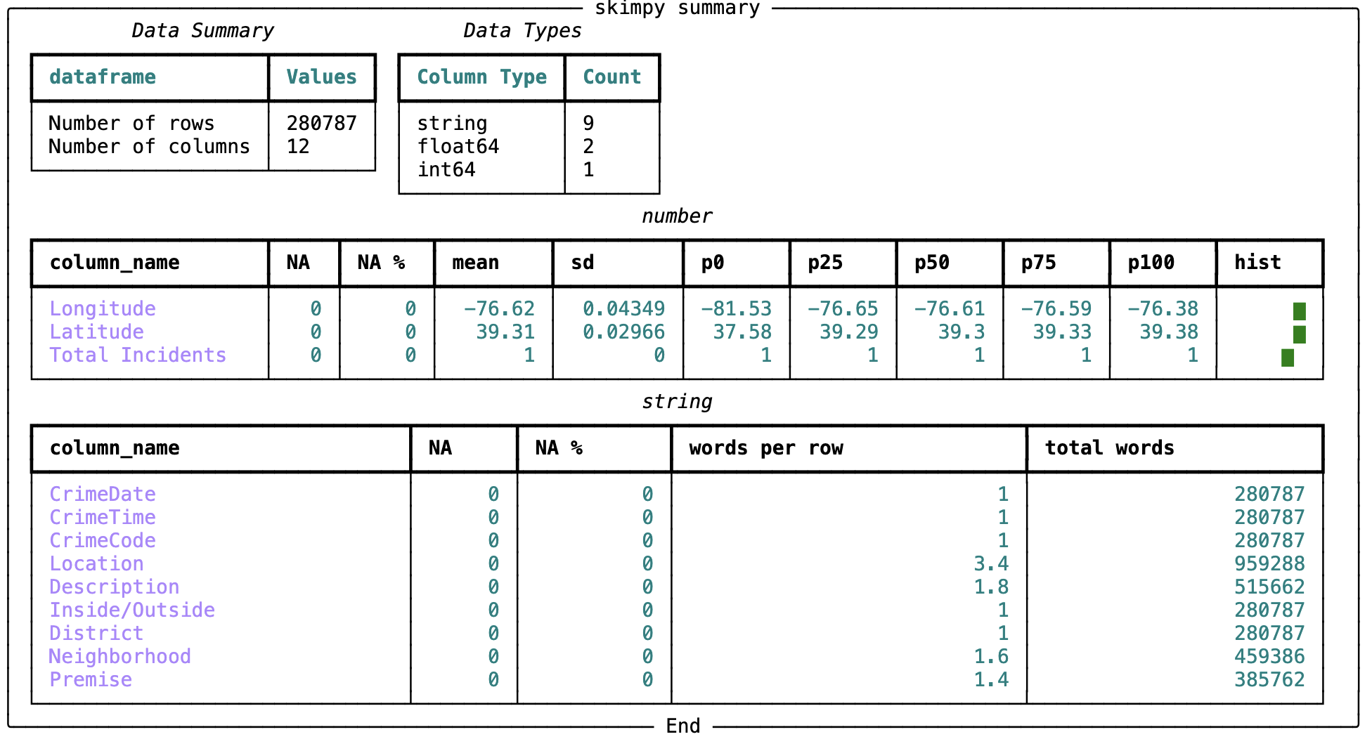
Data Cleaning
Location 1, vri_name1 and Weapon columns were dropped.
Deleted the rows where missing values were found.
Added the mode values to the Inside/Outside columns.
0% missing values were found after cleaning data.

Slide 4
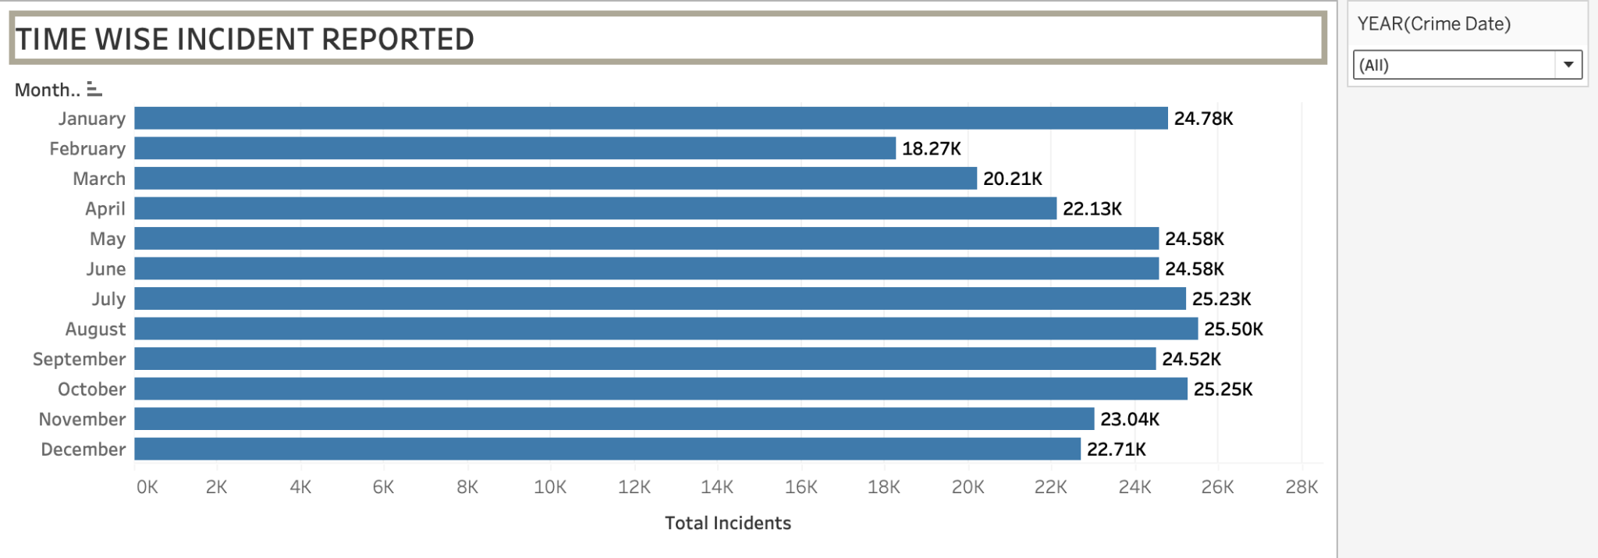
Insight 1 -Year and Month Wise crime analysis
2017 was year with most Criminal Activities.
Gradual Increase Over the Year
Crimes peaks in summer.
Lowest Incidents at Year's Start and End

Slide 5
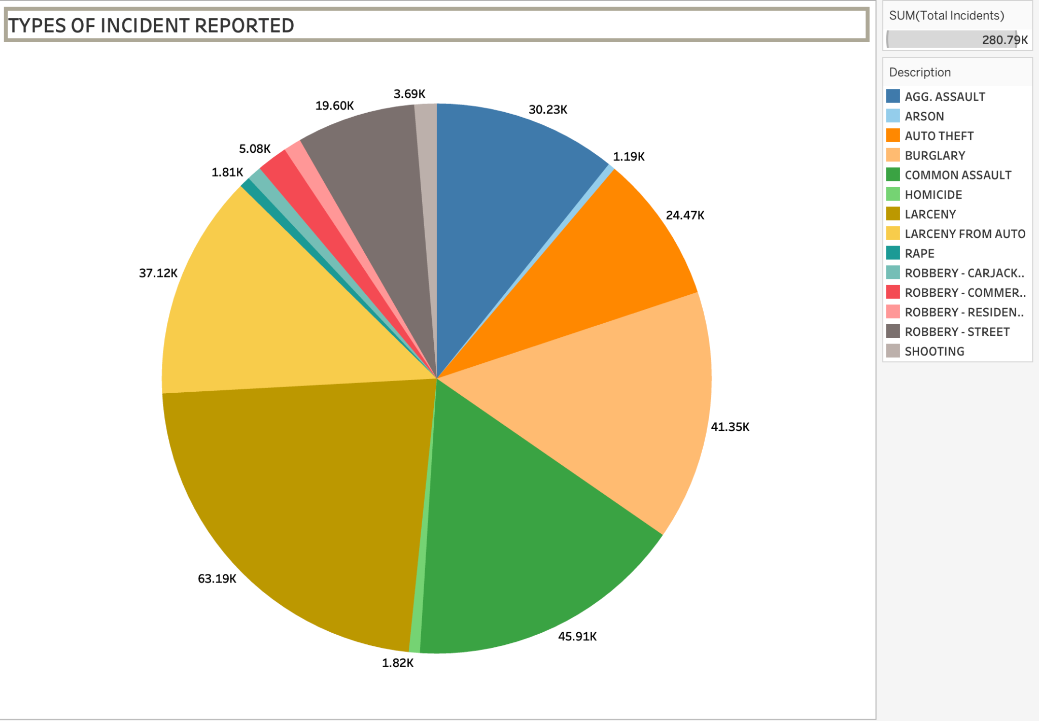
Insight 2 - Types Of Incident reported
Larceny Dominates Incident Types
High Frequency of Assault and Theft-Related Crimes
Lower Incidence of Violent Crimes Such as Homicide and Shooting.
Diverse Range of Incident Types.

Slide 6
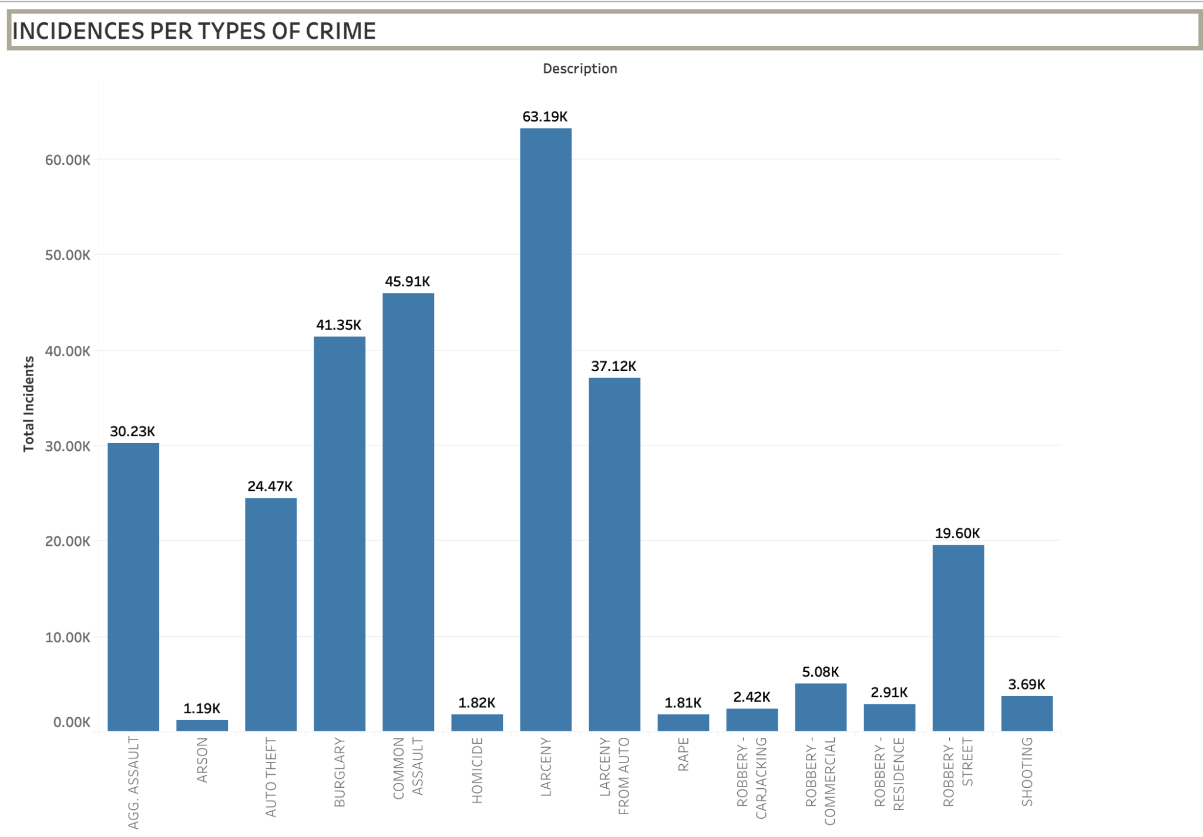
Insight 3
Significant Rates of Commercial Robbery
Dominance of Larceny
Lesser Incidence of Violent Crimes
Spread and Severity.

Slide 7
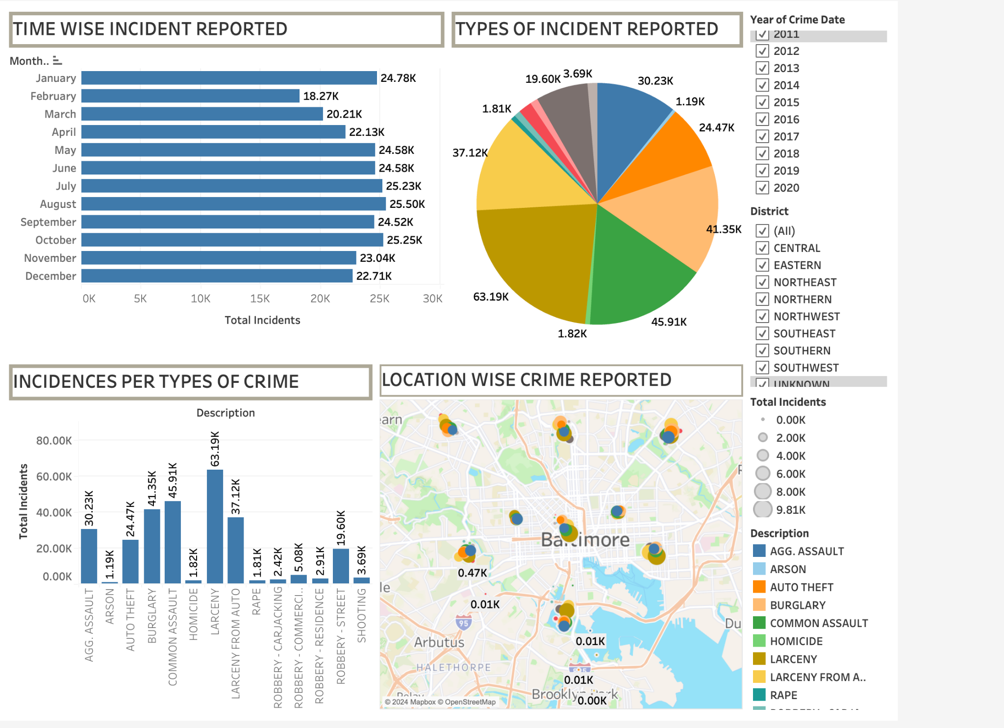
DASHBOARD

Slide 8
Conclusion
Property Crimes Prevalence: Larceny and commercial robbery are the most reported incidents, highlighting significant issues for law enforcement to address.
Assault and Robbery Impact: Violent crimes like assaults and robberies form a large portion of incidents, necessitating substantial policing resources.
Seasonal Crime Variations: Crime rates increase during spring and peak in summer, suggesting a need for seasonal adjustments in law enforcement strategies.
Strategic Resource Planning: Insights from data help in strategic resource allocation and planning, optimizing preventive measures and interventions during high-activity periods.

